Slide 1

NYC Airbnb Market
https://github.com/stephenschilling

Slide 2
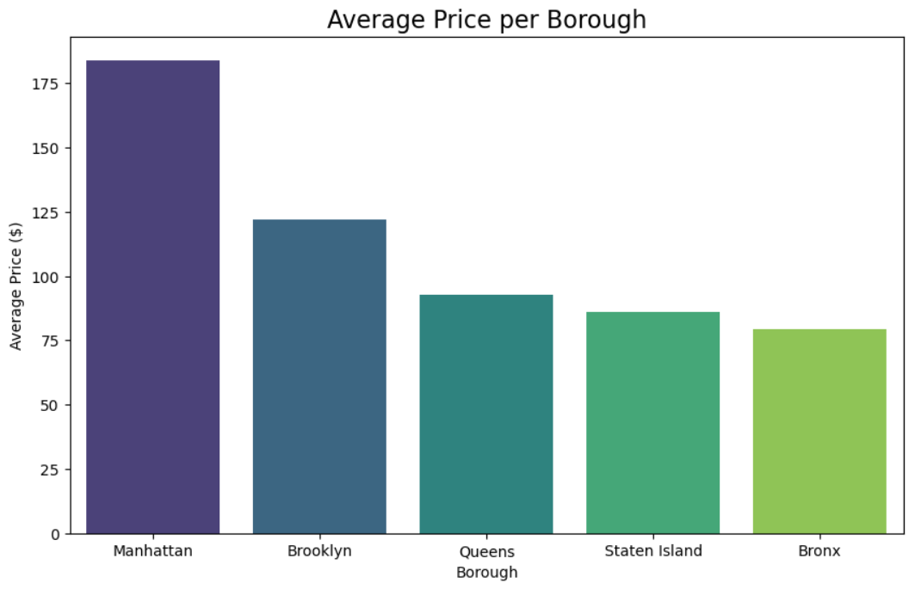
Average Price per Borough
Bar Chart to clearly compare costs. It highlights Manhattan as the premium location.

Slide 3
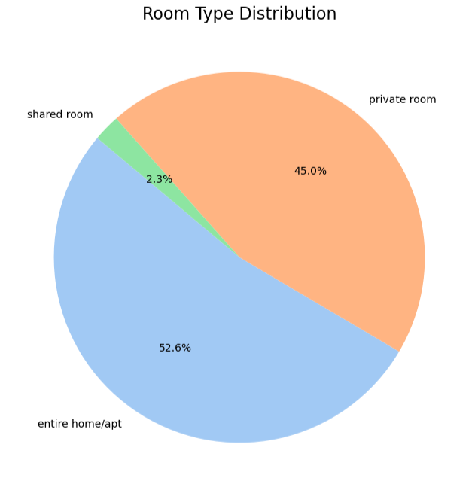
Room Type Distribution
Pie Chart to show the market share of Entire Homes vs. Private Rooms.

Slide 4
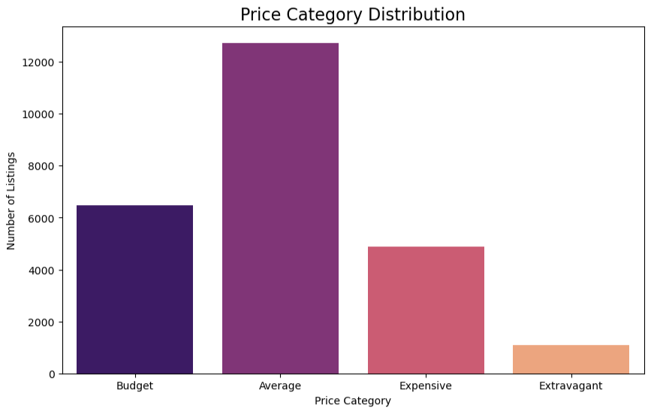
Price Category Distribution
Bar Chart to show the volume of listings in each tier.
It visually confirms that the "Average" price tier is the most populated.

Slide 5
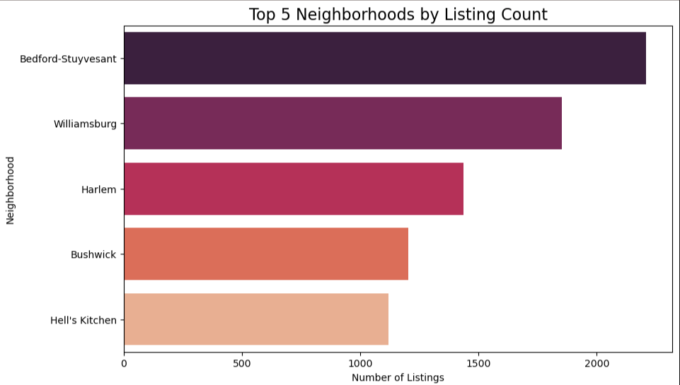
Top 5 Neighborhoods
Horizontal Bar Chart which is best for displaying long neighborhood names without them overlapping.

Slide 6
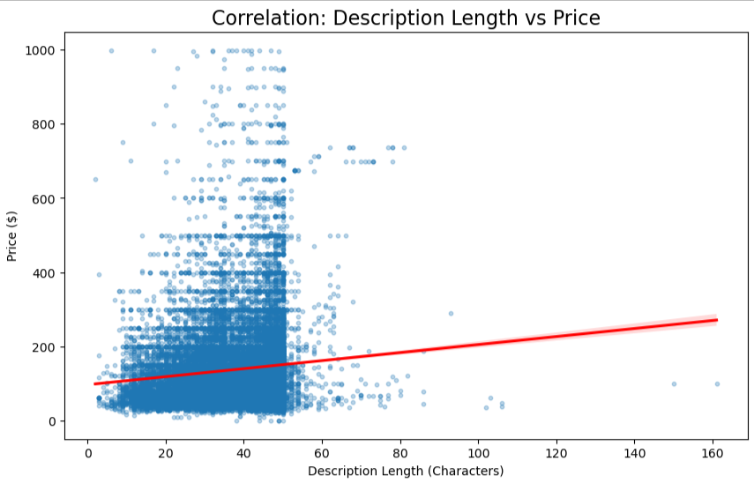
Description Length vs Price
The scatter plot shows a flat regression line, visually confirming the very low correlation.
This suggests that the length of the text doesn't drive price; factors like location and room type are far more important.
Length = Average Length of Stay

Slide 7
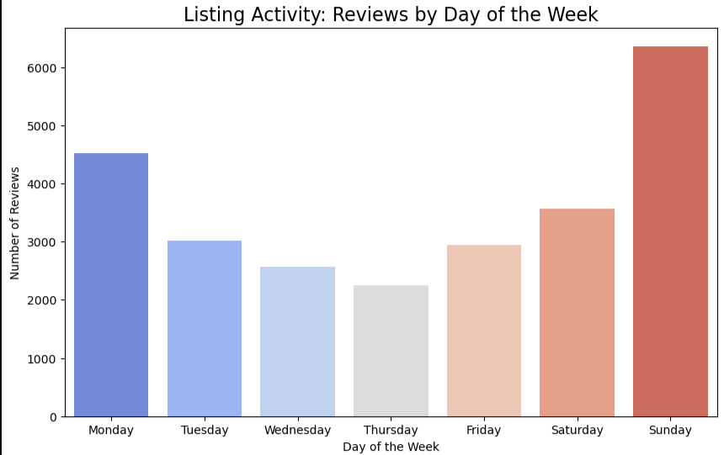
Review Days
The bar chart shows a clear peak in reviews on Saturdays and Sundays.
This likely reflects when guests check out and leave feedback after a weekend trip.

Slide 8
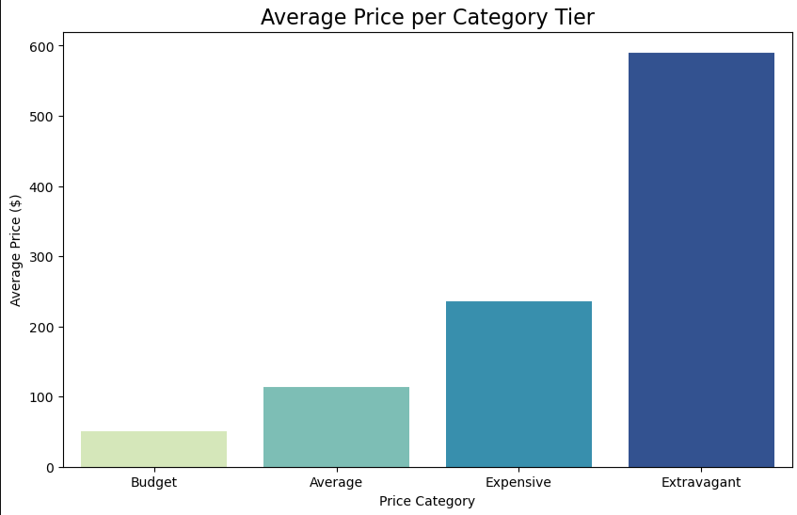
Price Tiers
The "Average Price per Category" graph provides a clear look at the distance between tiers.
For example, you can easily see that "Extravagant" listings average significantly more than "Expensive" ones, providing a clear visual of the luxury market gap.

Slide 9
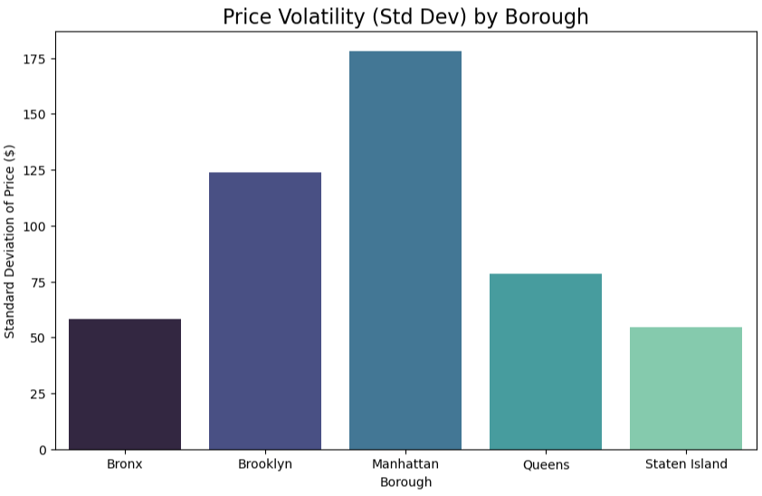
Price Volatility
This chart clearly illustrates that Manhattan has the widest variety of pricing (the highest bars),
Staten Island and the Bronx are more uniform in their offerings.

Slide 10
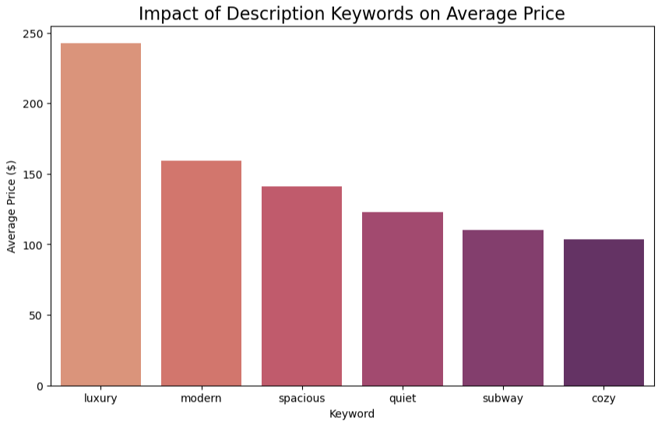
Keyword Impact
The visual confirms that listings describing themselves as "Luxury" or "Modern" significantly outprice those described as "Cozy" or "Subway."
This shows the "premium" value associated with certain marketing terms.

Slide 11
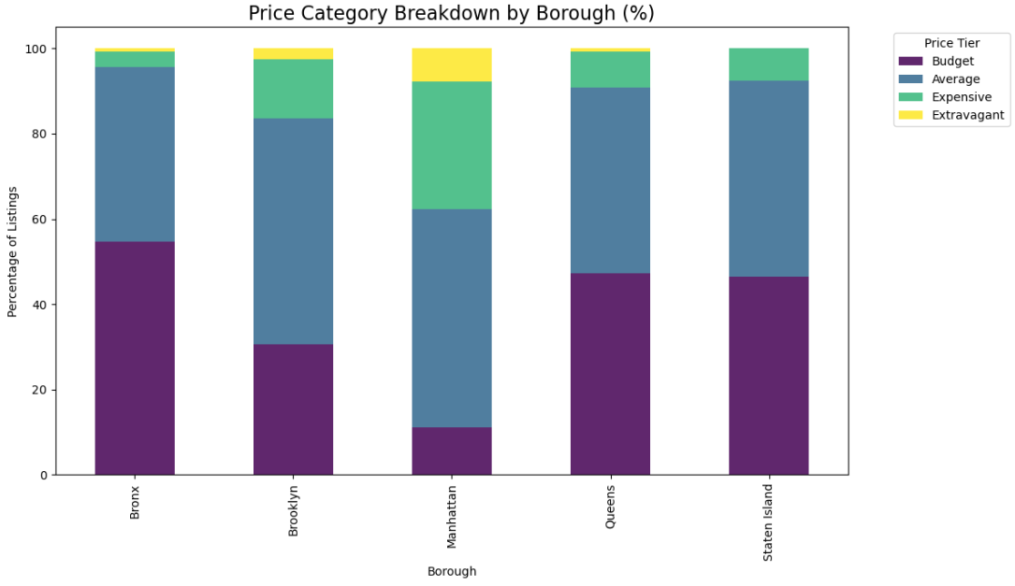
Borough Price Category Breakdown
The stacked bar chart is excellent for comparing the "vibe" of boroughs.
Bronx is dominated by the yellow/green "Budget" segments, while Manhattan has a much larger purple/dark segment for "Expensive" and "Extravagant" listings.

Slide 12
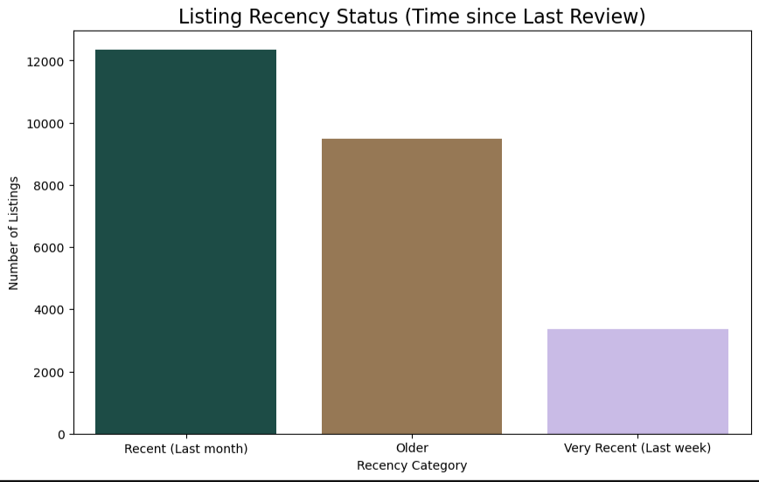
Listing Recency
This bar chart shows that majority of listings were active within the last month
The dataset represents a very "live" snapshot of the NYC market in 2019.

Slide 13
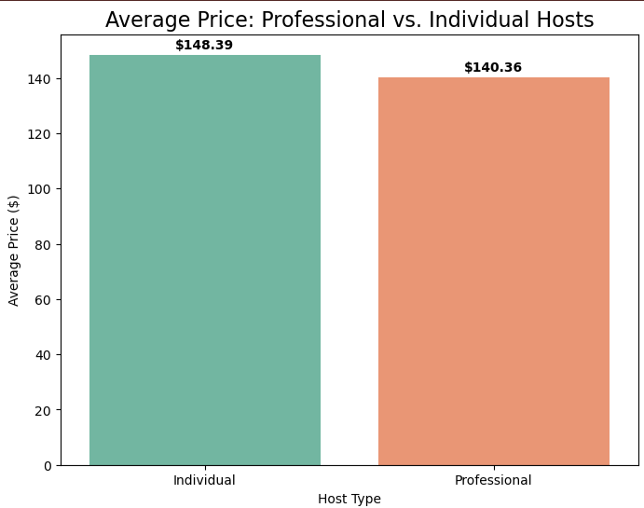
Professional vs. Individual Hosts
The bar chart visually demonstrates that Individual hosts list at a slightly higher average price point.
This is useful for debunking the assumption that professional management always implies higher prices.

Slide 14
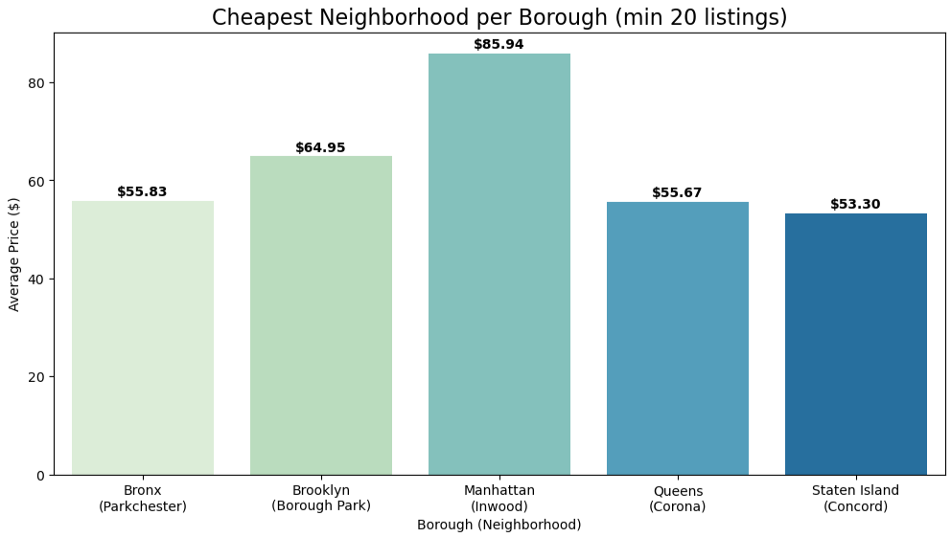
Best Value (Cheapest) Spots
By looking at the "Cheapest Neighborhood" chart, you can quickly identify the most affordable entry points in each borough.
It shows that Staten Island (Concord) and Queens (Corona) are the city's value leaders.

Slide 15
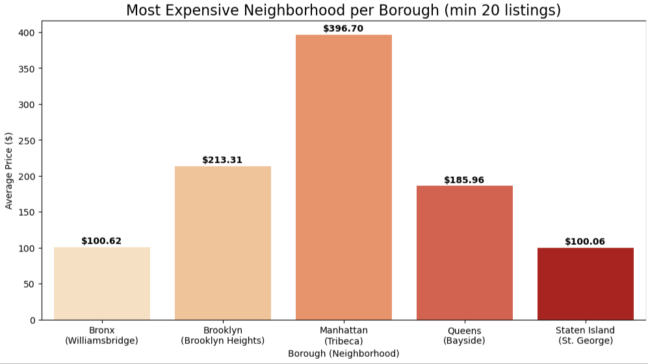
Luxury Hubs
The "Most Expensive" chart emphasizes the massive premium of Manhattan (Tribeca) compared to the luxury hubs of other boroughs.
While Brooklyn Heights is expensive, it is still significantly lower than Tribeca's nearly $\$400$ average.

